Slide 1
Occupancy Modelling CSP4141
Monday, May 21st, 2018
Introduction to unmarked R package
National Conservation Training Center Course
May 21st - 25th, 2018
Columbia River Fisheries Program Office

Slide 2

Introduction to ‘unmarked’
“Applied Hierarchical Modeling in Ecology: Analysis of distribution, abundance and species richness in R and BUGS”
Volume 1- Prelude and Static Models
Marc Kéry and J. Andrew Royle
2016

Slide 3
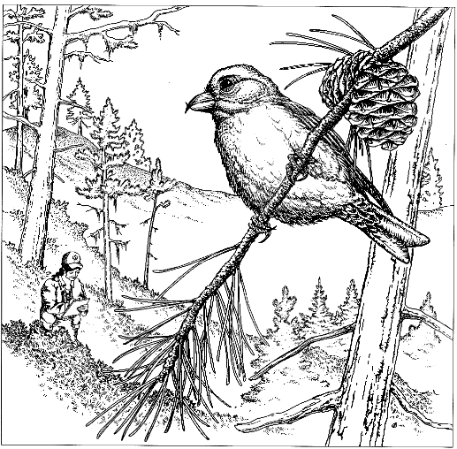
Introduction to ‘unmarked’
unmarked:
Statistical analysis of data from surveys of unmarked animals
Focus is on hierarchical models
Methods to estimate site occupancy, abundance, and density of animals
Imperfect detection

Slide 4
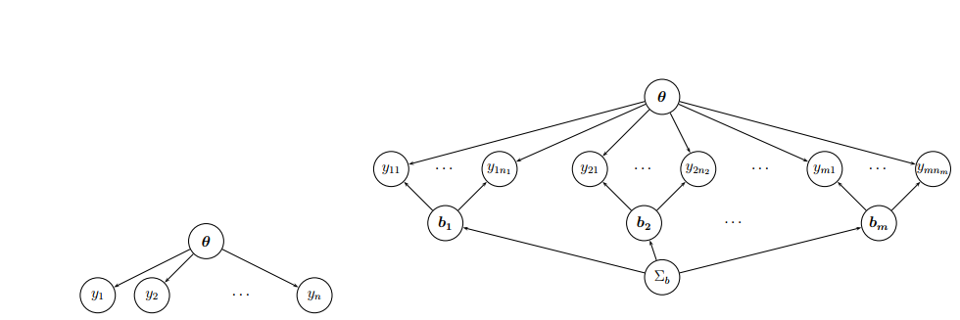
Hierarchical Modeling
Hierarchical model: Model with explicit components for observations and state process.
The ‘process’ model describes variation in the ecological process of interest
The ‘observation model’ contains the probabilistic description of what produced the observations

Slide 5
Hierarchical Modeling
(b)
(a)

Slide 6
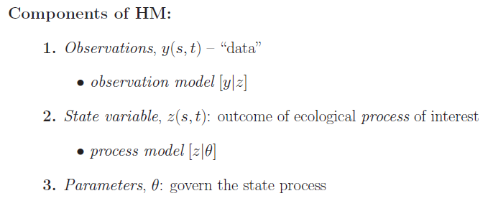
Hierarchical Occupancy Modeling
HM: model with explicit component models that describe 1) variations in the data due to (spatial/temporal) variation in ecological process and 2) due to an imperfect observation process (Royle and Dorazio 2008)

Slide 7
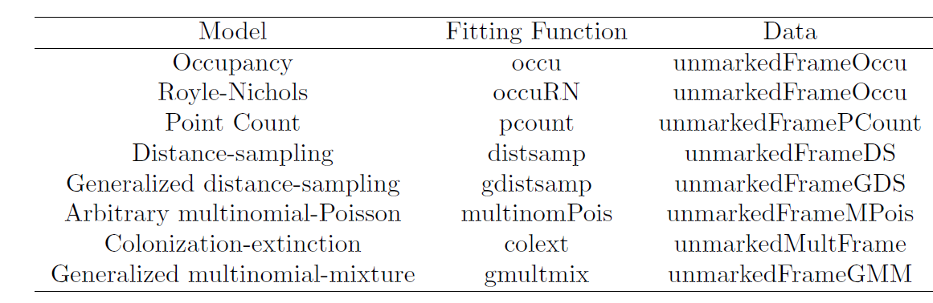
Unmarked hierarchical models

Slide 8
Unmarked hierarchical models
References to models accommodated in unmarked:
Single-season occupancy models (MacKenzie et al. 2002)
Royle-Nichols model (Ecology 2003)
Binomial N-mixture models (Royle 2004)
Distance sampling models (Royle et al. 2004)
“Open population” versions of the above (MacKenzie et al. 2003; Dail & Madsen 2011; Chandler et al. 2011)

Slide 9
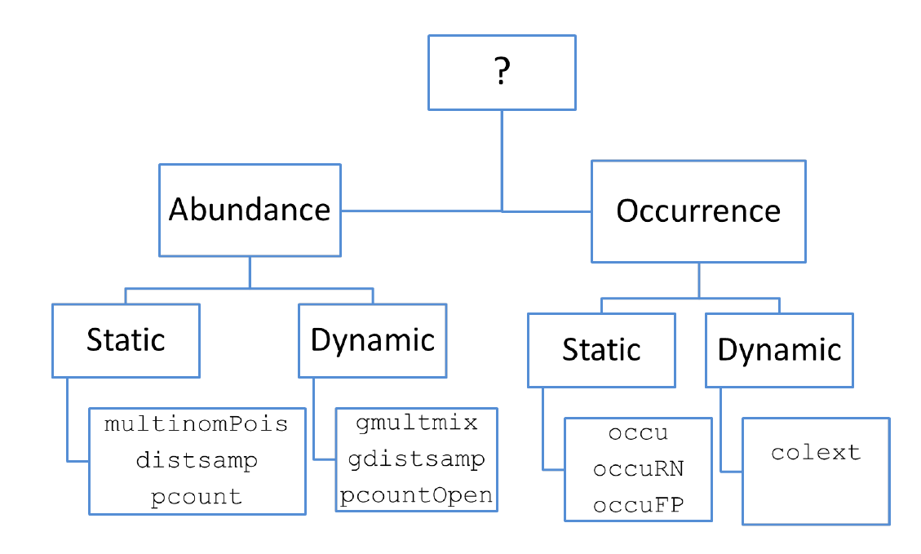
Which unmarked model to use?

Slide 10
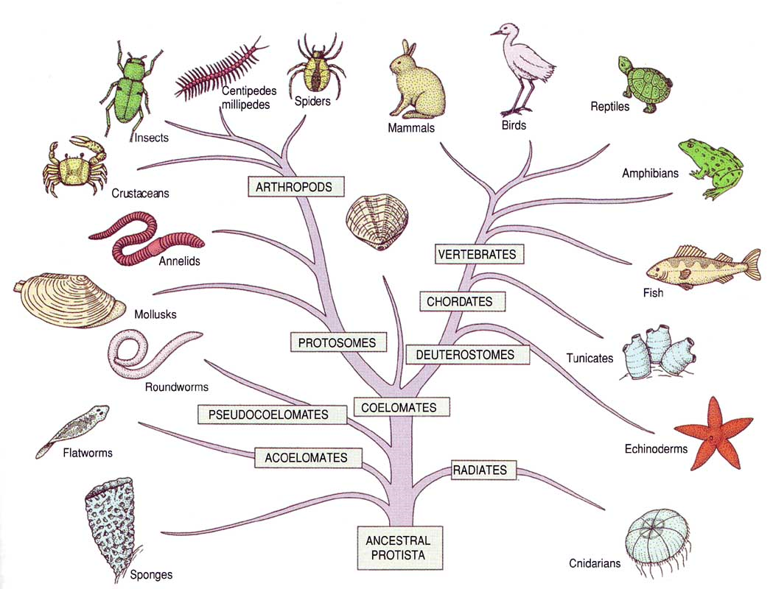
Unmarked data structure
Remember, R is fully objected-oriented.
Everything in R is an object: a single value, a vector of values, a data frames or list or complex data structures, but also functions, results of functions, graphics, and even formulas.
Clearly, not all objects are the same; the class of an object is its defined type.

Slide 11
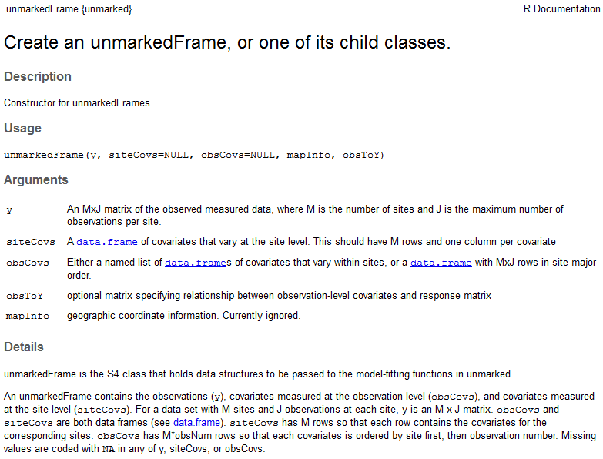
Unmarked data structure
All data must be put into an object called an ‘unmarkedFrame’

Slide 12
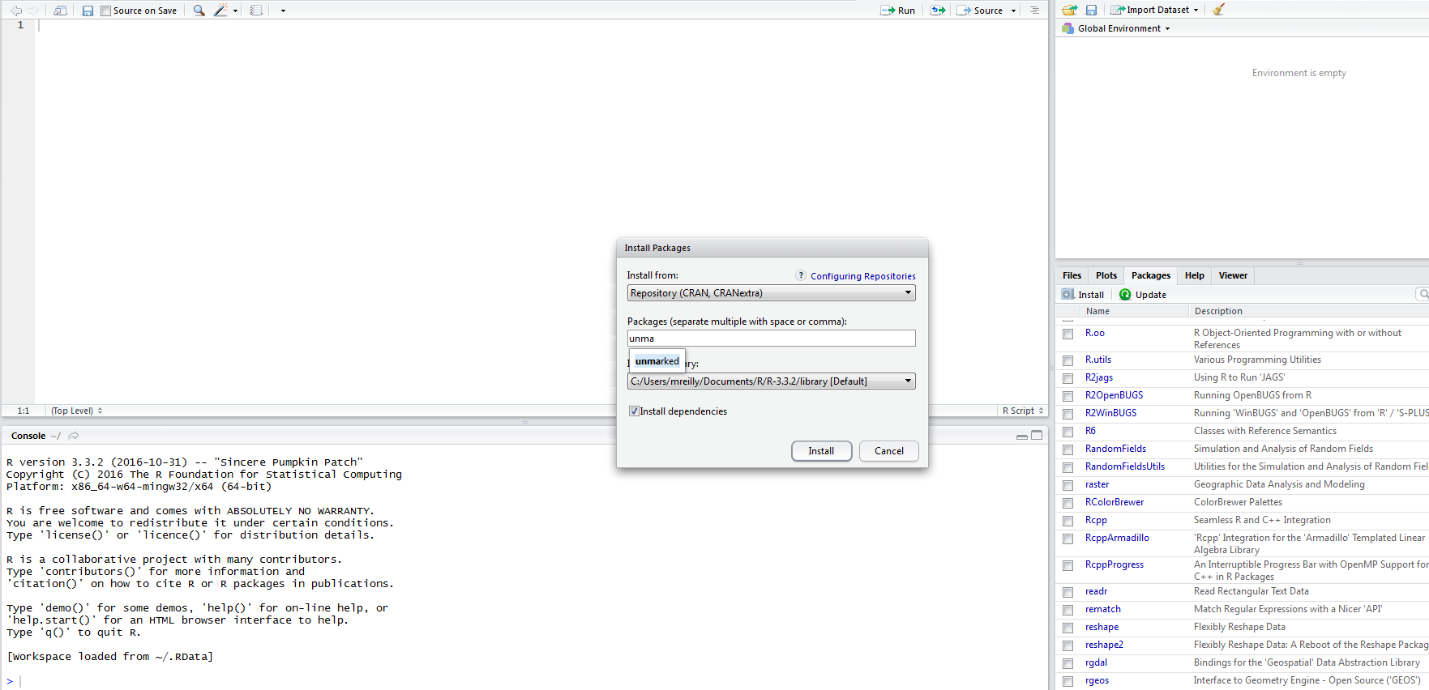
Unmarked data structure
What is an ‘unmarkedFrame?’
An unmarkedFrame (UMF) object contains components, referred to as slots, which hold the data and metadata.

Slide 13
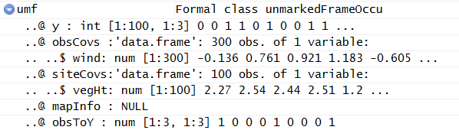
Unmarked data structure
What is an ‘unmarkedFrame?’ (Continued)
All UMF objects contain a ‘slot’ for the observation matrix y.
The y matrix is the only required slot.
Each row of y contains either the observed counts or detection/non-detection data at each of the M sites
All UMF objects contain a data.frame of site-level covariates (siteCovs) and a data.frame of observation-level covariates (obsCovs).

Slide 14
Unmarked data structure
Why do I need an ‘unmarkedFrame?’
Easier to detect errors when creating the UMF
Data structure (hierarchical) not amenable to simple data.frame
Allows for custom tools to summarize and visualize data

Slide 15
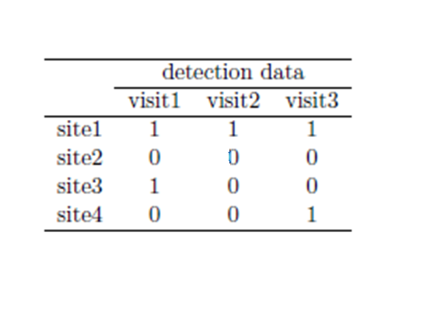
Unmarked data structure
Sample units are called ‘sites’
There are multiple ‘observations’ at each site
If using site-occupancy model, we make multiple ‘visits’ to each site
If using a double-observer framework, then we have 2 observations per site

Slide 16
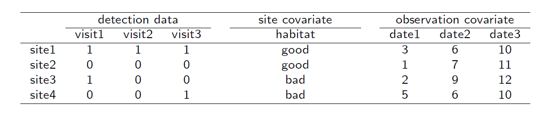
Unmarked data structure
Covariates can be recorded
These can be site-specific or observation specific

Slide 17
Covariates
Site-specific
constant within a site, but can differ among locations
e.g., habitat characteristics
Survey-specific (observations)
may vary among surveys
e.g., streamflows, water levels, visibility

Slide 18
Unmarked data structure
Most unmarkedFrame components:
Component | Description
y | nSite x nObs matrix of observations
siteCovs | nSite x nObs data.frame of site-specific covariates
obsCovs | A list with nCovs components. Each component is nSite x nObs data.frame of covariate

Slide 19
Unmarked data structure
Some unmarkedFrame have additional components:
Component | Description
y | nSite x nObs matrix of observations
siteCovs | nSite x nObs data.frame of site-specific covariates
obsCovs | A list with nCovs components. Each component is nSite x nObs data.frame of covariate
numPrimary | The number of primary period (seasons, yrs, etc.)
dist.breaks | A vector defining the distance intervals for a distance sampling analysis
unitsIn | Measurement units for distance data

Slide 20
Introduction to ‘unmarked’

Slide 21

Where do we start? Where do we go?
Data
Import data
Format data
Create unmarkedFrame
Fit models
Analyze results
Assess model fit
Make predictions
Maps
Etc.

Slide 22
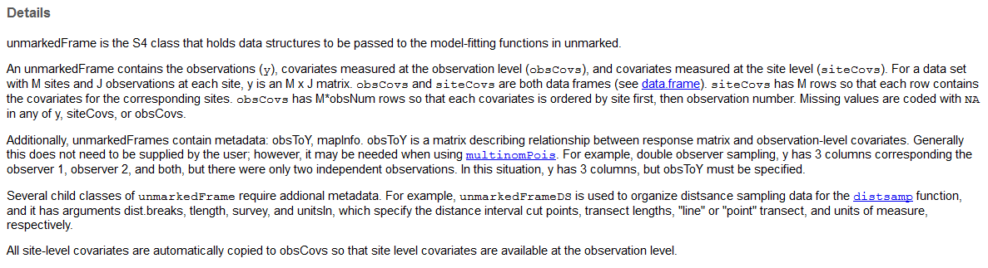
Unmarked Workflow
1. Data
-Process and package the data into an ‘unmarkedFrame’ using standard constructor functions that ensure data are in the proper format

Slide 23
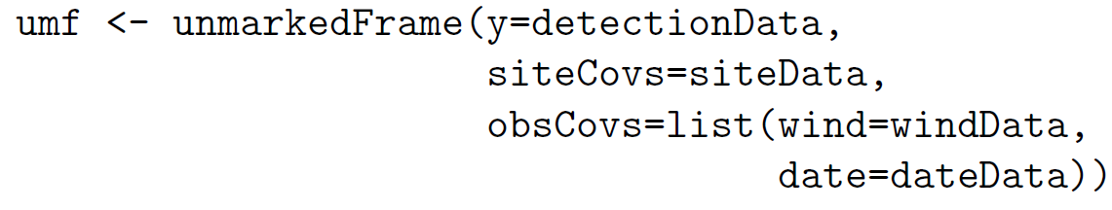
Unmarked data structure
All data must be put in an object called an unmarkedFrame

Slide 24
Unmarked hierarchical models

Slide 25
Unmarked – ‘occu’
This function fits the single season occupancy model of MacKenzie et al (2002).
‘occu’ fits the standard occupancy model based on zero-inflated binomial models (MacKenzie et al. 2006, Royle and Dorazio 2008).
The occupancy state process (z_{i}) of site i is modeled as:
z_{i}∼Bernoulli(ψ_{i})
The observation process is modeled as:
y_{ij}|z_{i}∼Bernoulli(z_{i}p_{ij})

Slide 26
Workflow Example
# Part 1 (Import data and create unmarkedFrame)
library(unmarked)
OccuData <- read.csv(“myOccuData.csv”)
siteCovariates <-read.csv(“mySiteCovariates.csv”)
OccuUMF <-unmarkedFrameOccu(y=OccuData, siteCovs=siteCovariates)

Slide 27
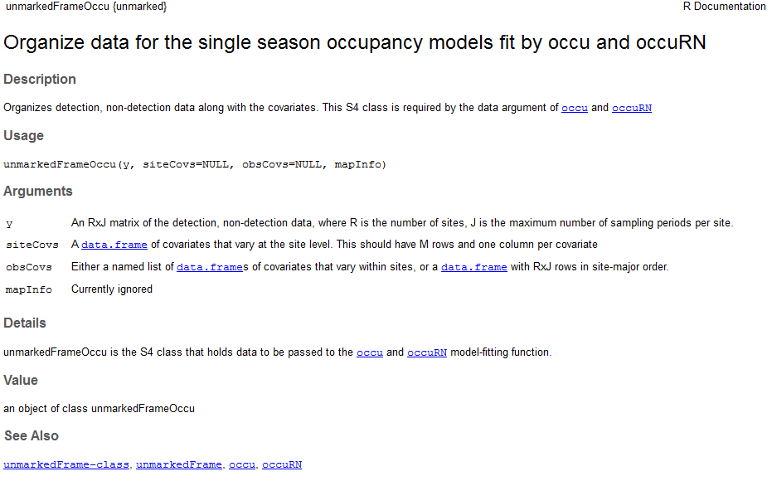
Unmarked Models

Slide 28
Workflow Example
# Part 1 (Import data and create unmarkedFrame)
library(unmarked)
OccuData <- read.csv(“myOccuData.csv”)
siteCovariates <-read.csv(“mySiteCovariates.csv”)
OccuUMF <-unmarkedFrameOccu(y=OccuData, siteCovs=siteCovariates)

Slide 29
Workflow Example (continued)
#Part 2 (Fit models) (remember: formula then data)
fm1 <-occu( ~1~1, data=OccuUMF)
fm2 <-occu( ~vegHt ~vegHt, data=occuUMF)

Slide 30
Unmarked hierarchical models

Slide 31
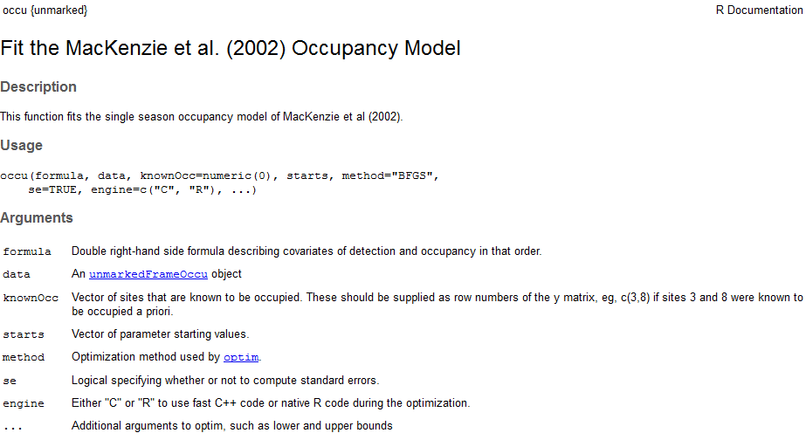
Unmarked Models

Slide 32
Workflow Example (continued)
#Part 2 (Fit models) (formula then data)
fm1 <-occu( ~1~1, data=OccuUMF)
fm2 <-occu( ~vegHt ~vegHt, data=occuUMF)

Slide 33
Workflow Example (continued)
#Part 3. (model selection, model fit, etc.)
fms <- fitList(fm1, fm2)
modSel(fms)
Parboot(fm2)
Predictions <- (predict(fms, type=“state”,
newdata=mapdata)
Levelplot <-Predicted~x.coord+y.coord,
data=predictions)

Slide 34
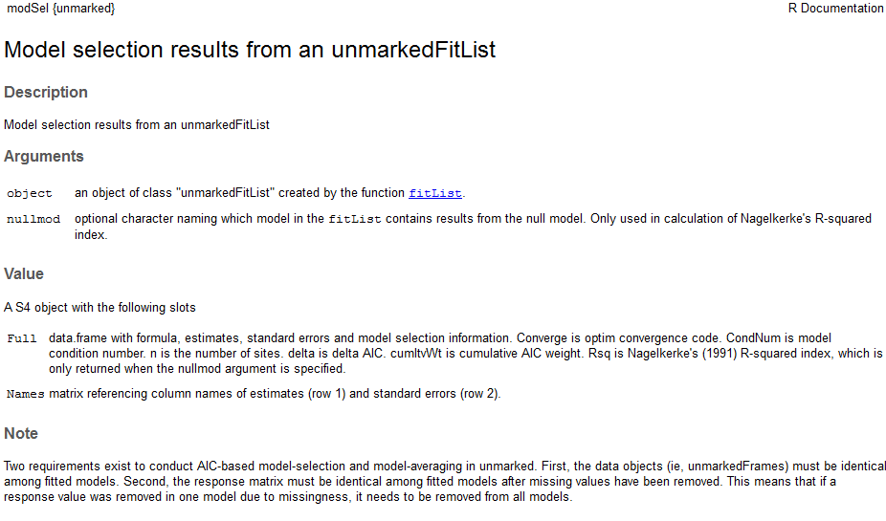
Unmarked Models

Slide 35
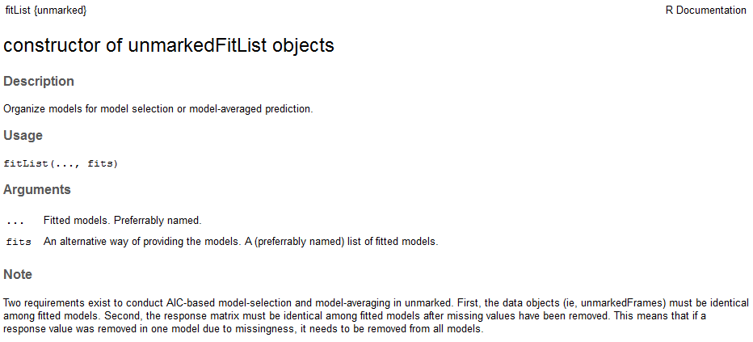
Unmarked Models

Slide 36
Workflow Example (continued)
#Part 3. (model selection, model fit, etc.)
fms <- fitList(fm1, fm2)
modSel(fms)
Parboot(fm2)
Predictions <- (predict(fms, type=“state”,
newdata=mapdata)
Levelplot <-Predicted~x.coord+y.coord,
data=predictions)

Slide 37
In-class follow along example…
Open Rmarkdown file:
“4. Unmarked Workflow.docx”

Slide 38
Online Resources
Here are our suggestions for the best on-line resources for information about R.
The R Project homepage. Look here for official news from the R Project, plus links to documentation, mailing lists, the official R FAQs, and more
StackOverflow. Got a question about R? Search for questions tagged with "r" and you'll probably find your question already answered. If not, ask away
R bloggers. For a steady stream of news, tips and articles related to R follow this blog aggregator for posts from dozens of R bloggers, including the team from Revolution Analytics
#rstats on Twitter. To listen in on (or contribute to) an information-rich conversation about R 140 characters at a time, search for the #rstats hastag
Books about R. If you're looking for some offline reading, the R Project has an extensive list of R books, as does the R Programming Language tag on Amazon.com

Slide 39
Online Resources
Unmarked Google group
http://groups.google.com/group/unmarked
hmecology: hierarchical modeling in ecology Google group
http://groups.google.com/group/hmecology

Slide 40
Referenced Material
Royle and Dorazio 2008. “Hierarchical Modeling and Inference in Ecology: The Analysis of Data from Populations, Metapopulations, and Communities”
MacKenzie et al. 2002, “Estimating Site Occupancy Rates when Selection Probabilities are Less than One.”

